Slide 1

T3/Tutorials: Data Submission
T3 and the Android Field Book
https://triticeaetoolbox.org/

Slide 2
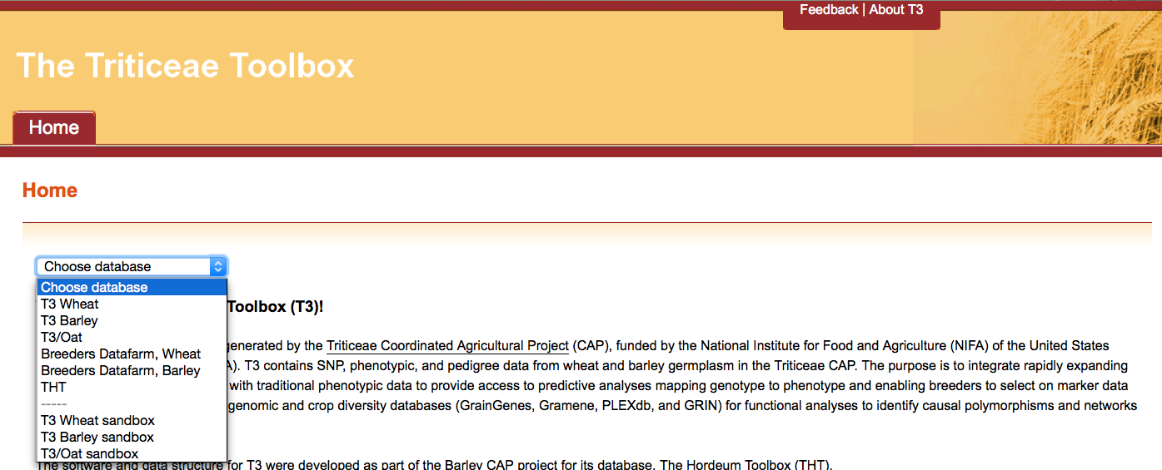
The Triticeae Toolbox (T3)
Each of the T3 databases can be reached from the T3 homepage: https://triticeaetoolbox.org
T3/Oat will be used for demonstration purposes but these instructions are applicable to each instance of T3

Slide 3
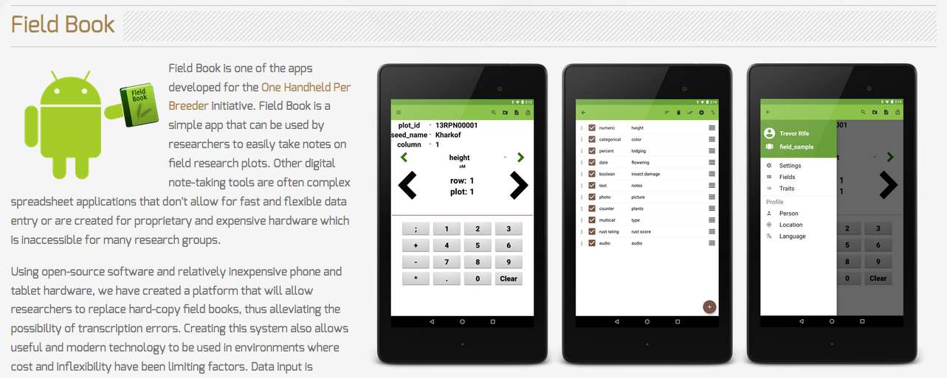
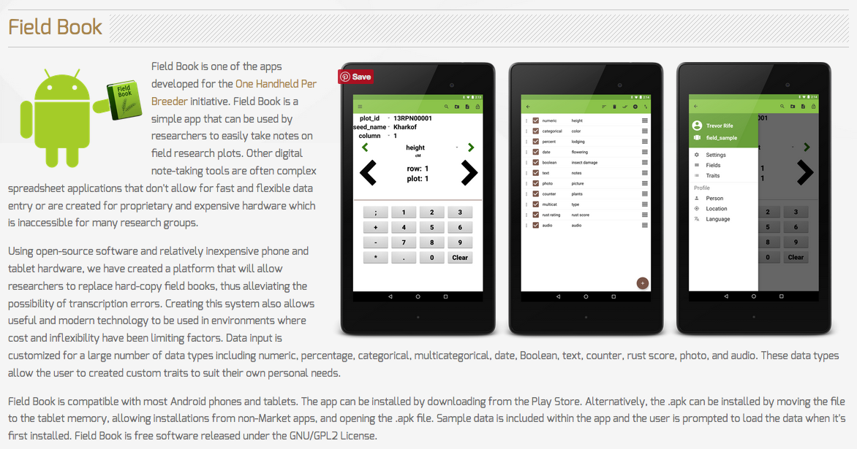
The Android Field Book
The Android Field Book program was created by the Poland lab (Kansas State University). The program can be downloaded from:
http://www.wheatgenetics.org/bioinformatics/22-android-field-book.html

Slide 4
T3 and the Android Field Book
T3 provides a series of tools that interface with the Android Field Book (AFB) program:
T3 tools can be used to generate
A field layout file
A phenotypic trait file
These two files are required to begin recording measurements using the AFB
Trial results recorded in the AFB
can be uploaded directly to T3

Slide 5
T3 and the Android Field Book app
How to begin recording results using the AFB and T3:
Create a trial in T3 (or use an existing T3 trial)
Create a field layout for the T3 trial
Download a field layout from T3 in the AFB format
Download a file of T3 traits in the AFB format
Import the field layout and trait file to the AFB app
Begin recording results using your
tablet

Slide 6
Tutorial 7: Outline
The “Manage Phenotype Trials” tool
Creating and uploading a new T3 trial
Creating a T3 field layout
Uploading a T3 field layout to the Sandbox
Downloading AFB files from the Sandbox
Importing files to the AFB
Recording measurements in the AFB
Exporting trial results from the AFB
Uploading AFB trial results to the Sandbox
Submitting the AFB trial to T3

Slide 7
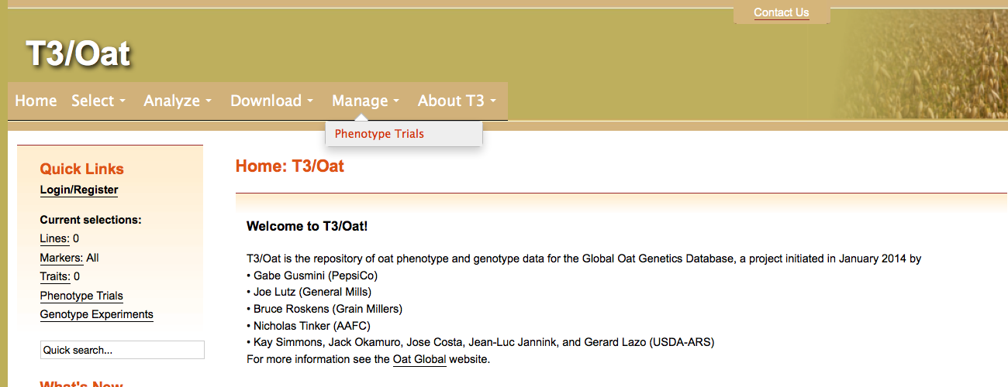
Section 1: The “Manage Phenotype Trials” tool
Navigate to the T3/Oat homepage at https://triticeaetoolbox.org/oat/
The “Manage Phenotype Trials” tool can be used to:
Create a new T3 trial
Create a field layout for a new or an existing T3 trial

Slide 8

Section 1.1: Creating and uploading a new T3 trial
It is necessary to provide trial information before a field layout can be generated using T3 tools. This trial information is not used by the AFB app.
To create a new T3 trial using the “Manage Phenotype Trials” tool:
First select the set of lines in the trial using one of the line selection tools
Then navigate to the Manage menu> Phenotype Trials

Slide 9
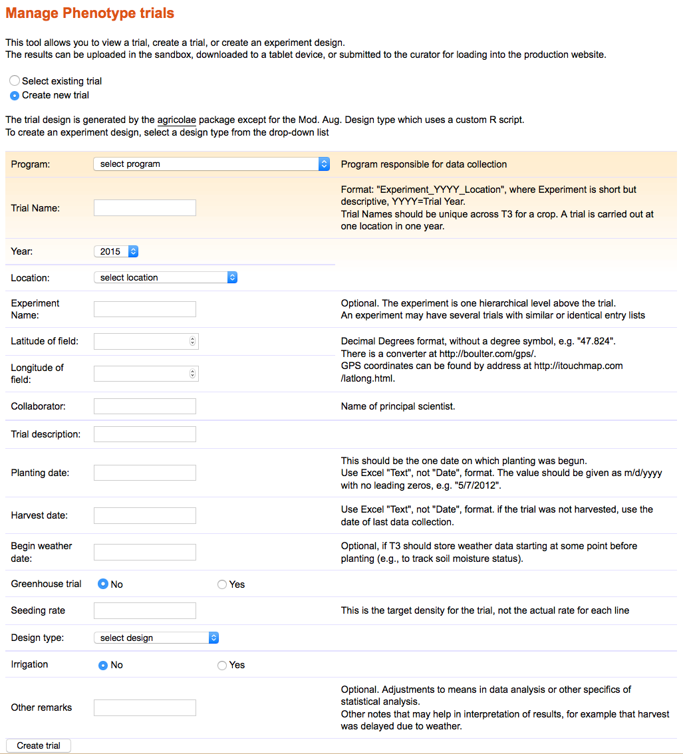
Section 1.1: Creating and uploading a new T3 trial
To create a new T3 trial:
Select “Create new trial” at the top of the page
Fill out the form
Please contact the curator if you do not see the value that you require in a drop-down menu
* If you select an experimental design then you can create and download a field layout at this stage (see section 1.2)
Click “Create trial”
Download the trial description
Upload the trial description to the relevant Sandbox
1
2
*
3

Slide 10
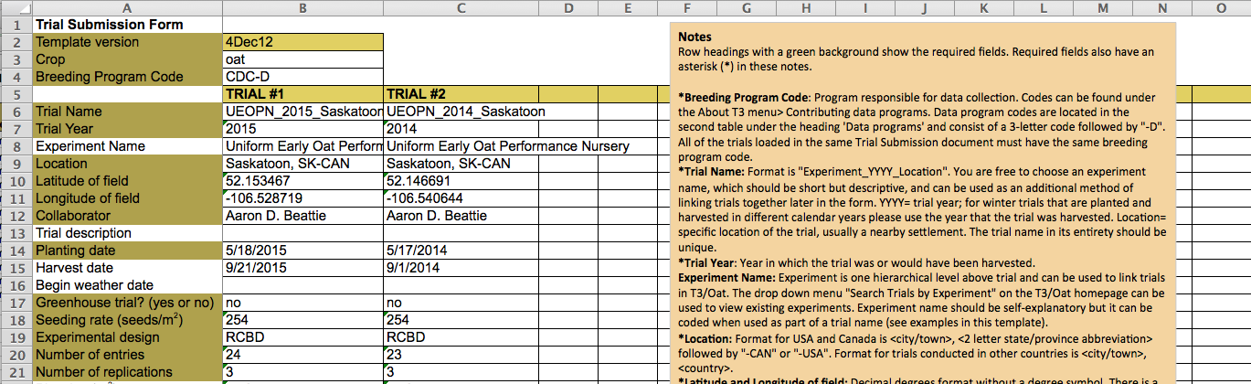
Section 1.1: Creating and uploading a new T3 trial
The trial description file generated by the “Manage Phenotype Trials” tool is in the format required for upload to T3
Alternatively, a trial description template (below) can be used to upload trial information for one or more trials, or to edit existing trial information
The template is available from the Data Submission page in the About T3 menu
See the T3 phenotype data tutorial for help uploading trial information to the Sandbox

Slide 11
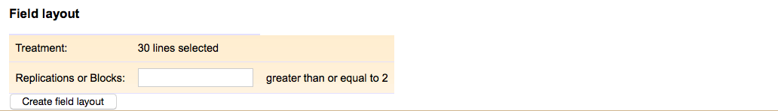
Section 1.2: Creating a T3 field layout
A field layout for a new T3 trial can be created at the same time as the trial description (see section 1.1) using the “Manage Phenotype Trials” tool.
Select an experimental design
Depending on the design selection you will be prompted to specify:
The number of replicates
The block size
The checks
Click “Create field layout”
Download the field layout
The field layout for a new T3 trial will use the lines in the “current selections”.
1
2
3

Slide 12
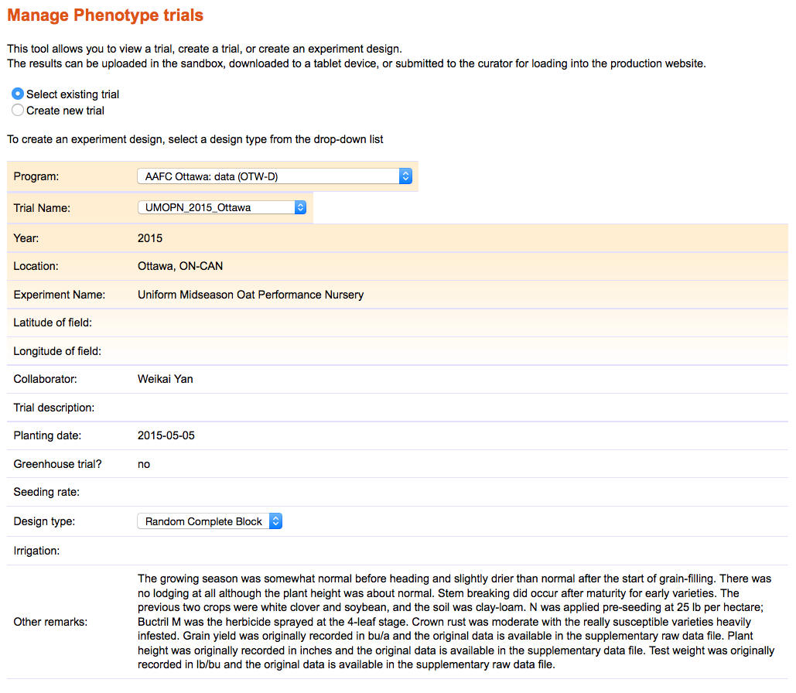
Section 1.2: Creating a T3 field layout
To create a field layout for an existing T3 trial:
Choose “Select existing trial” at the top of the page
Select the breeding program responsible
Select the trial name
Choose an experimental design
Depending on the design selection you will be prompted to specify:
The number of replicates
The block size
The checks
Click “Create field layout”
Download the field layout
The field layout for an existing T3 trial will use the lines in the “current selections”, unless the trial already has trial results stored in T3.
1
2
3
4
5
6

Slide 13
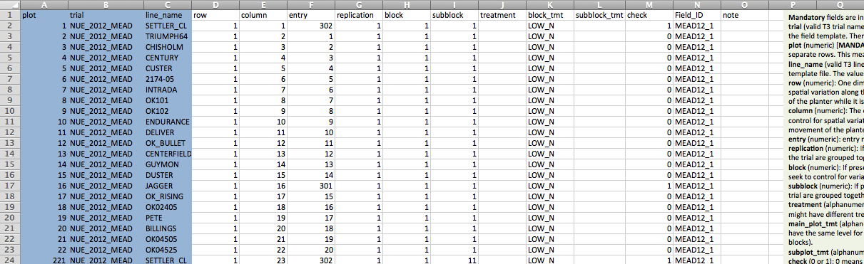
Section 1.2: Creating a T3 field layout
The field layout file generated by the “Manage Phenotype Trials” tool is in the format required for upload to T3
This is not the same as the Android Field Book format
Alternatively, the Fieldbook template (below) can be used to upload a field layout
The template is available from the Data Submission page in the About T3 menu
It is necessary to supplement the information held in a field layout generated using the “Manage Phenotype Trials” tool before uploading it to T3
The “row” and “column” fields are required but are not filled in by the T3 tool
Please follow the instructions in the Fieldbook template if you wish to fill in the remaining optional fields

Slide 14
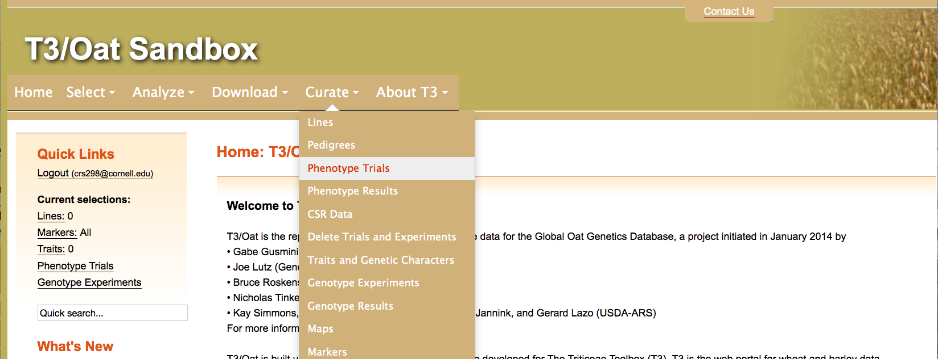
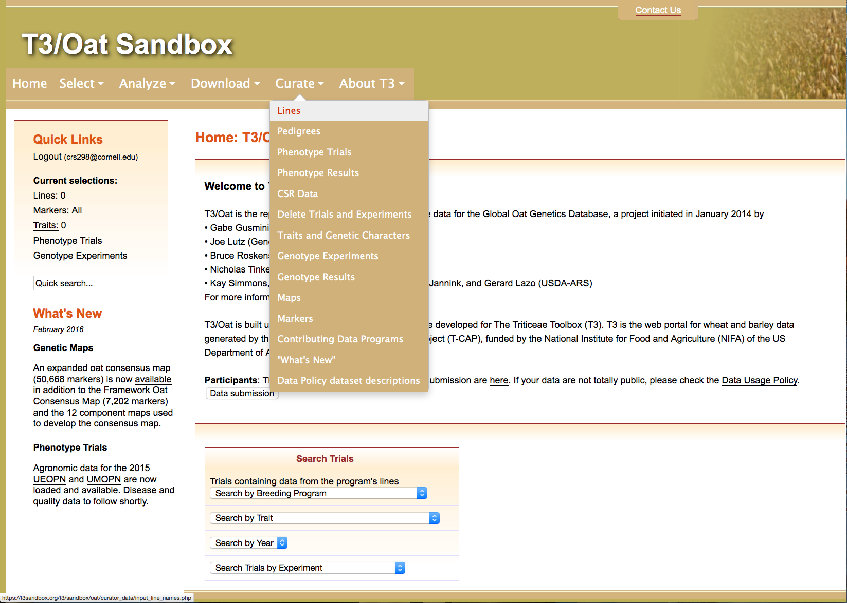
Section 1.3: Uploading a T3 field layout to the T3/Oat Sandbox
Navigate to the T3/Oat Sandbox at https://t3sandbox.org/t3/sandbox/oat/
The curation menu will appear once you register and login
Choose the Curate menu> Phenotype Trials

Slide 15
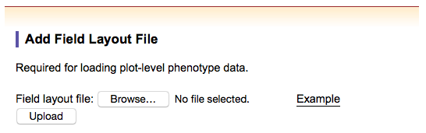
Section 1.3: Uploading a T3 field layout to the T3/Oat Sandbox
The sandbox allows you to test load your template. The T3/Oat Sandbox reverts to an exact copy of T3/Oat overnight.
Browse for and upload the field layout file, created using either:
The “Manage Phenotype Trials” tool
The field layout template

Slide 16
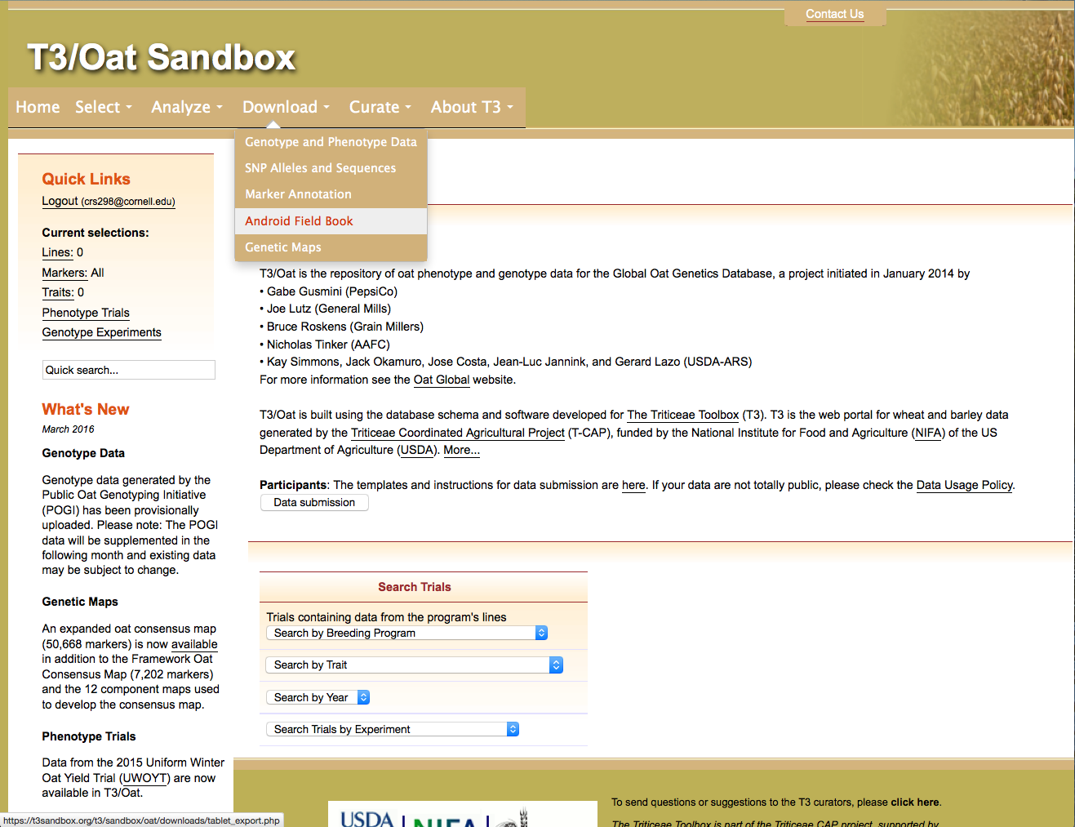
Section 2: Downloading Android Field Book files from the T3/Oat Sandbox
You should now have loaded a trial description and a field layout to the T3/Oat Sandbox
If you have not yet submitted these files to the production version of T3/Oat then the next step should be carried out in the T3/Oat Sandbox
Choose the Download menu> Android Field Book

Slide 17
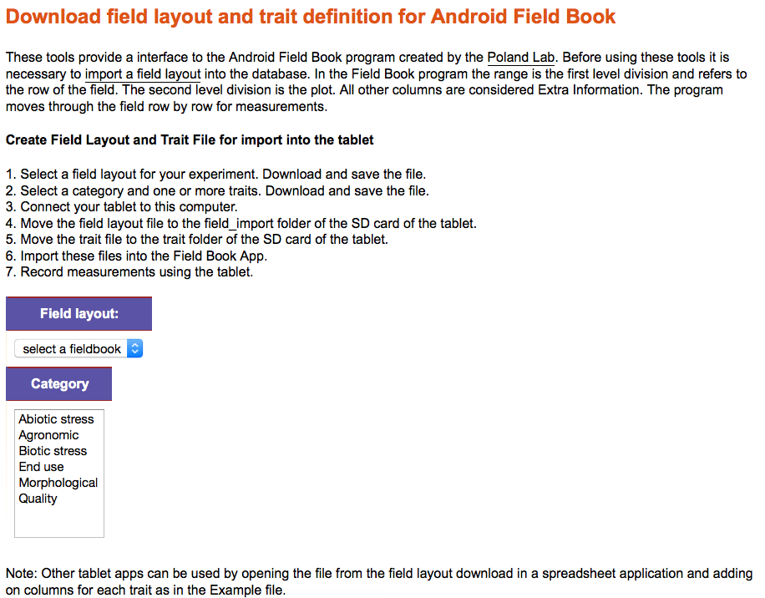
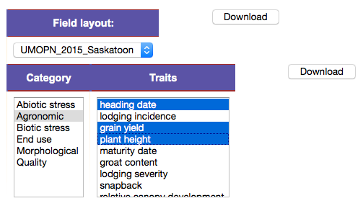
Section 2: Downloading Android Field Book files from the T3/Oat Sandbox
Select the required field layout from the drop-down menu.
To download T3 traits:
Choose a trait category
Select one or more traits
Hold Ctrl (PC) or ⌘ (Mac)
Click “Download”
Navigate to the About T3 menu> Trait Descriptions for more details about the traits available in T3/Oat.

Slide 18
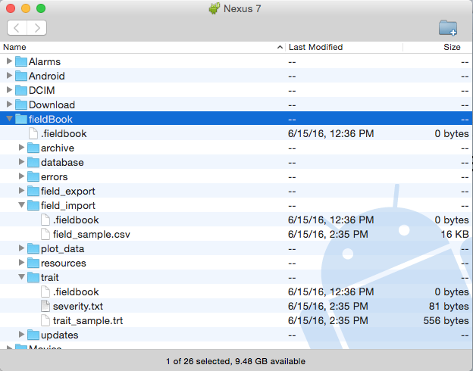
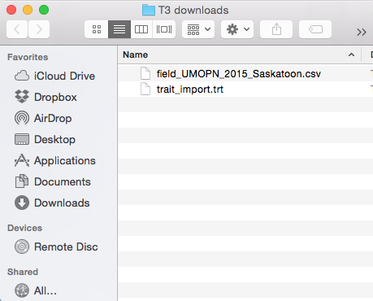
Section 3: Importing files to the Android Field Book
Connect your tablet to your computer
Move the two files downloaded from T3/Oat into the Android Field Book folder on your tablet
The Android File Transfer program for Mac (other methods of loading the files to the AFB are available)
A folder containing the field layout and the file of T3 traits downloaded from T3/Oat in sections 1 & 2 of this tutorial

Slide 19
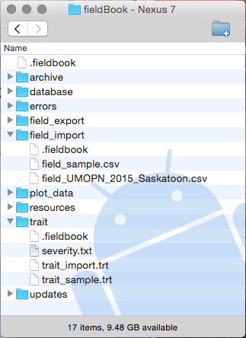
Section 3: Importing files to the Android Field Book
The field layout should be placed in the folder called “field_import”
The file of T3 traits should be placed in the folder called “trait”
These two files enable you to begin recording results using the AFB app.

Slide 20
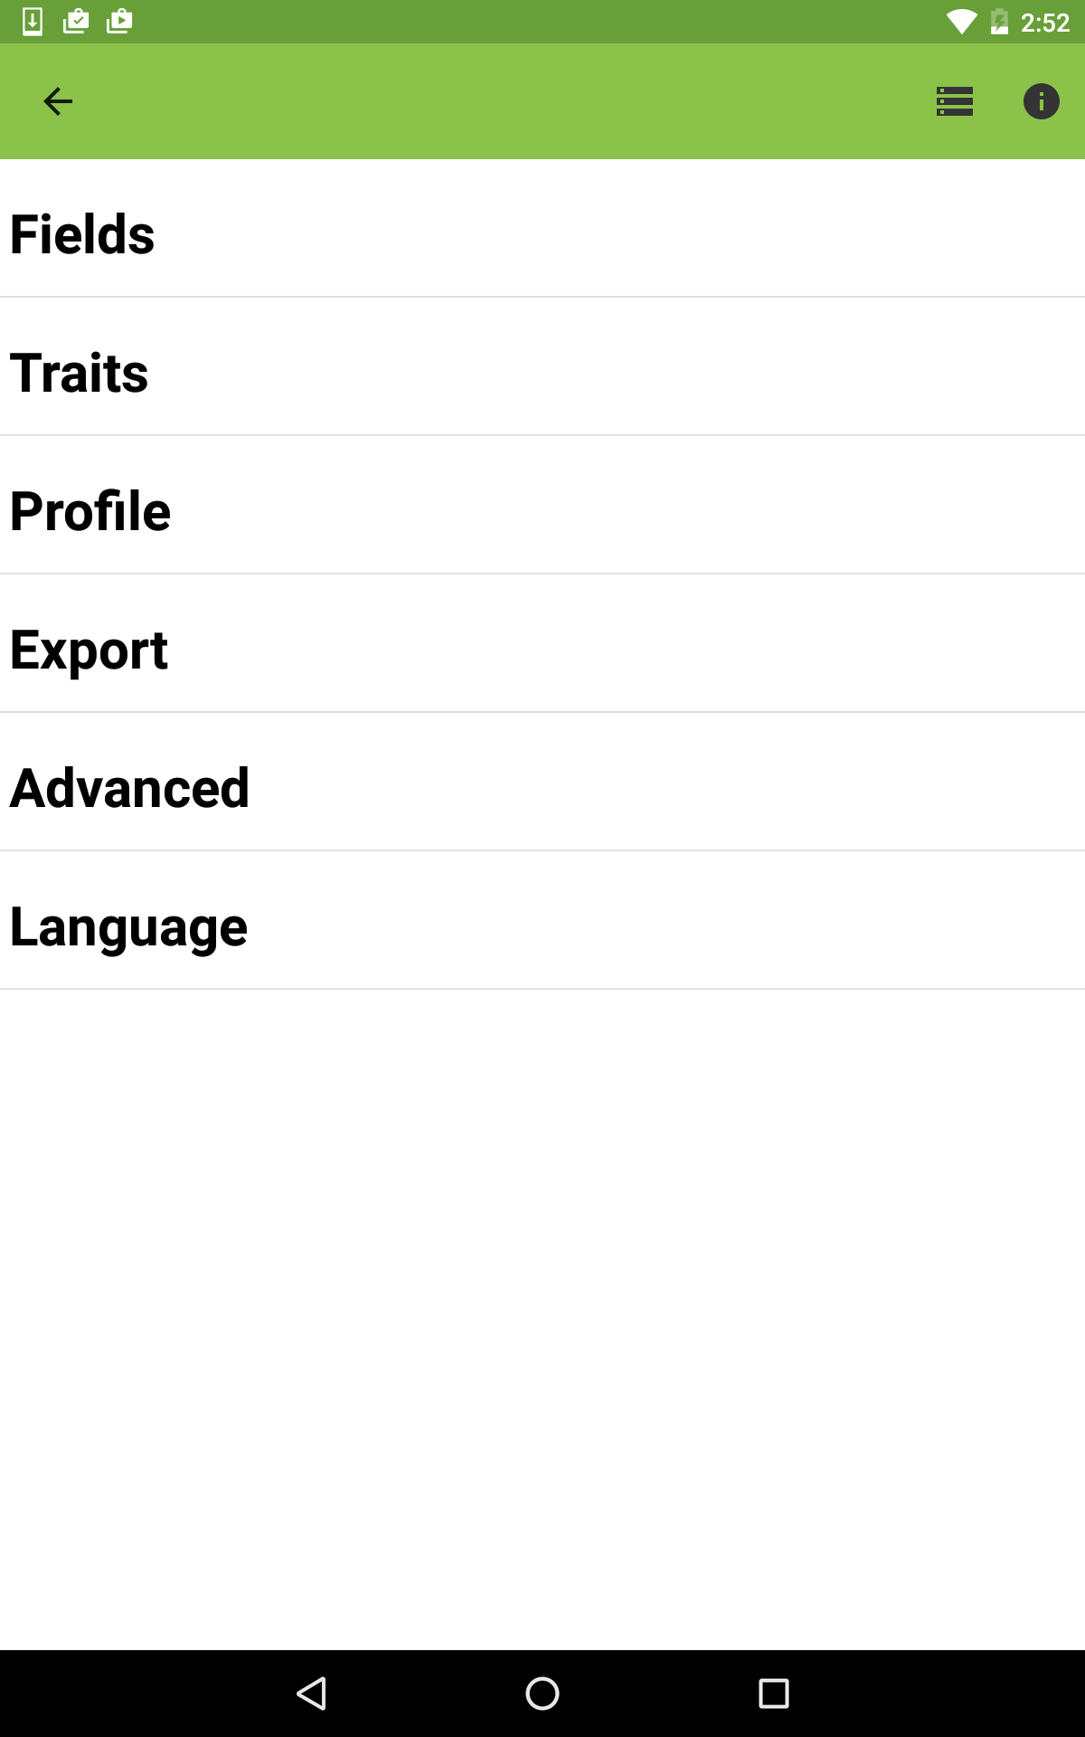
Section 3: Importing files to the Android Field Book
To begin using the AFB app you must first load the field layout and the trait file in the app
Open the AFB app on your tablet
Navigate to the settings menu

Slide 21
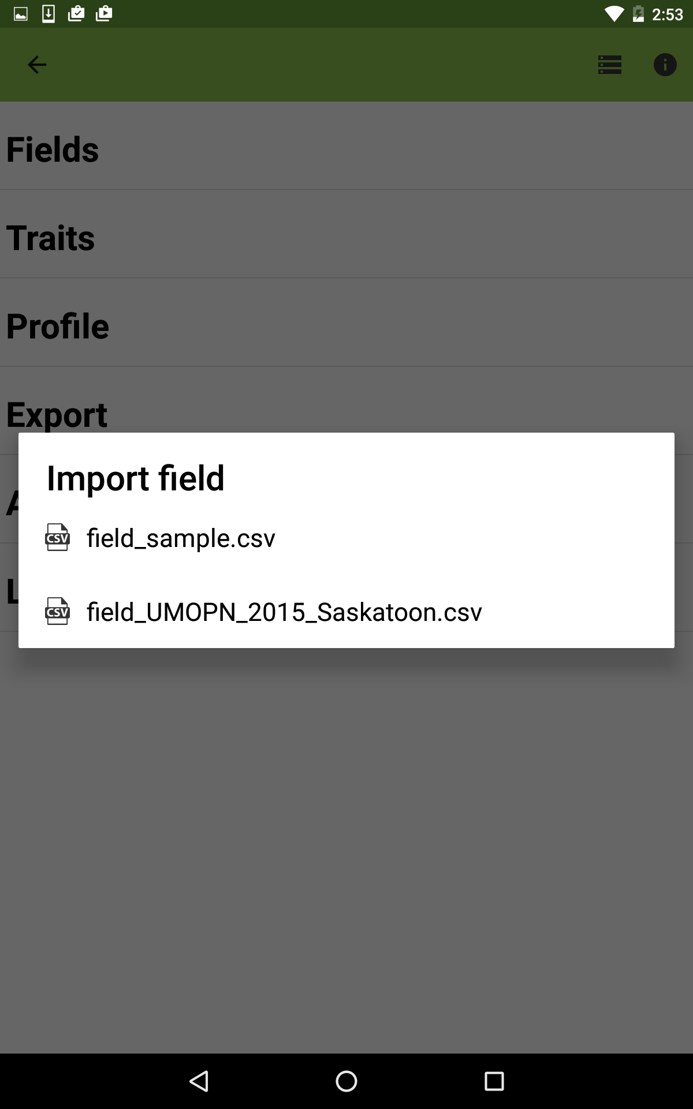
Section 3: Importing files to the Android Field Book
To load the field layout:
Select “Fields” from the settings menu
Select the relevant field layout file from the “Import field” window

Slide 22
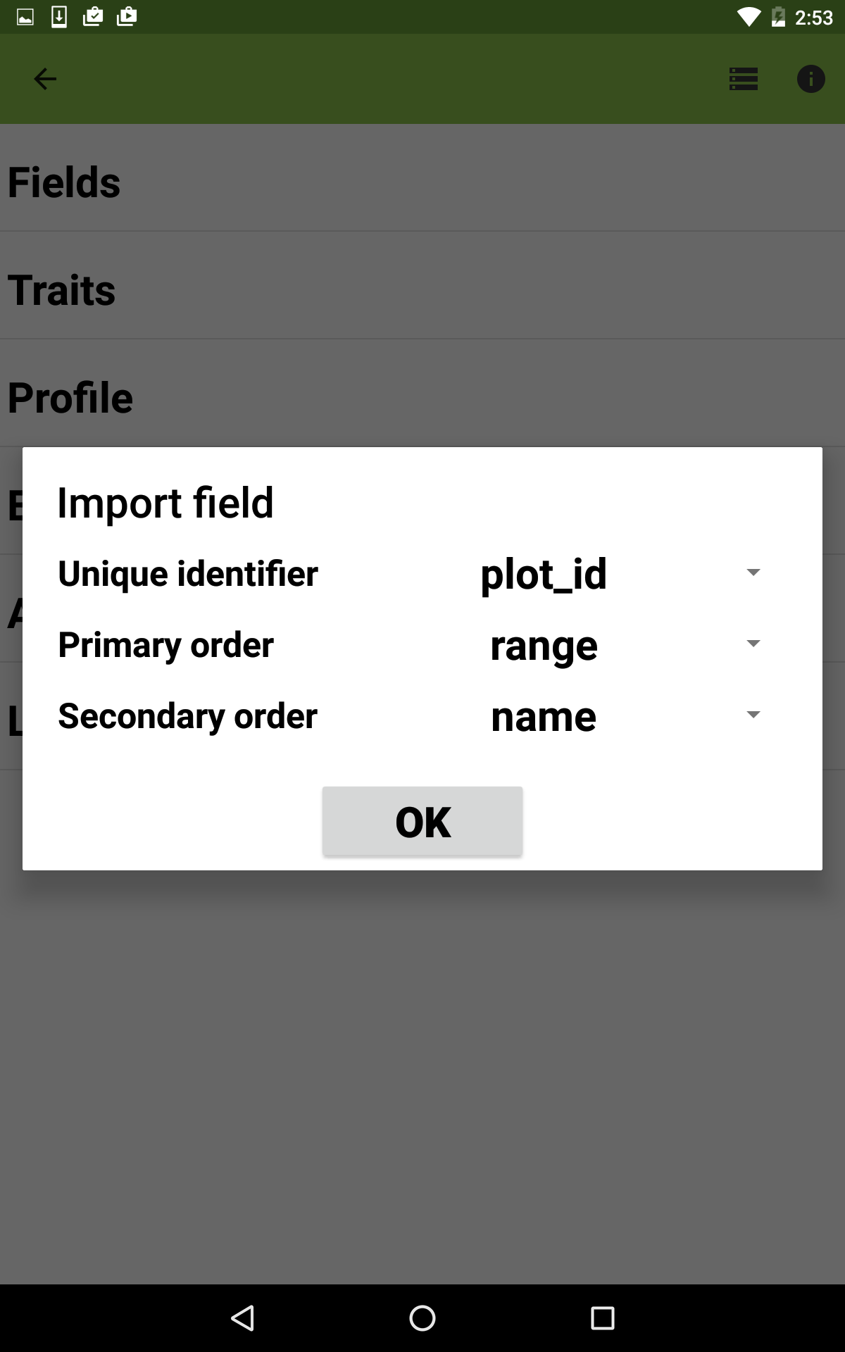
Section 3: Importing files to the Android Field Book
Select the plot_id as the unique identifier
Choose which fields to use for the primary and secondary order
Click “OK”

Slide 23
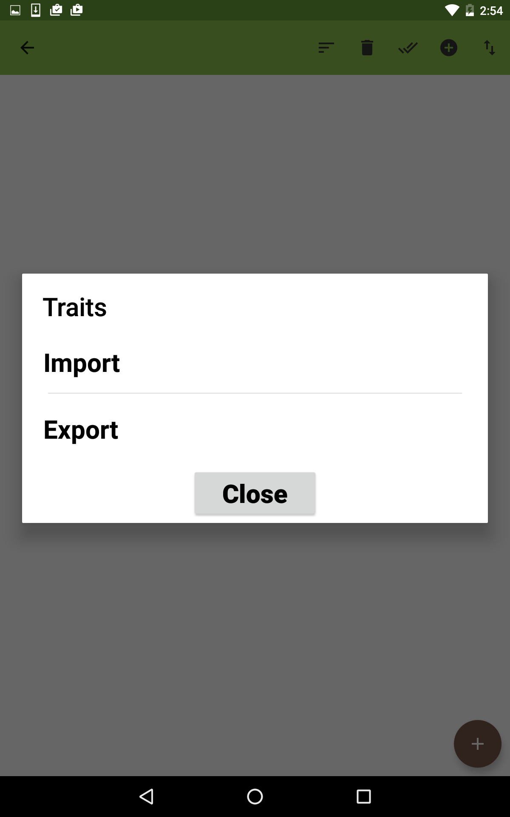
Section 3: Importing files to the Android Field Book
To load the T3 traits:
Select “Traits” from the settings menu
Select the ⬆⬇ symbol in the top right corner of the traits screen
Choose to “Import” traits
Select the relevant T3 trait file when prompted

Slide 24
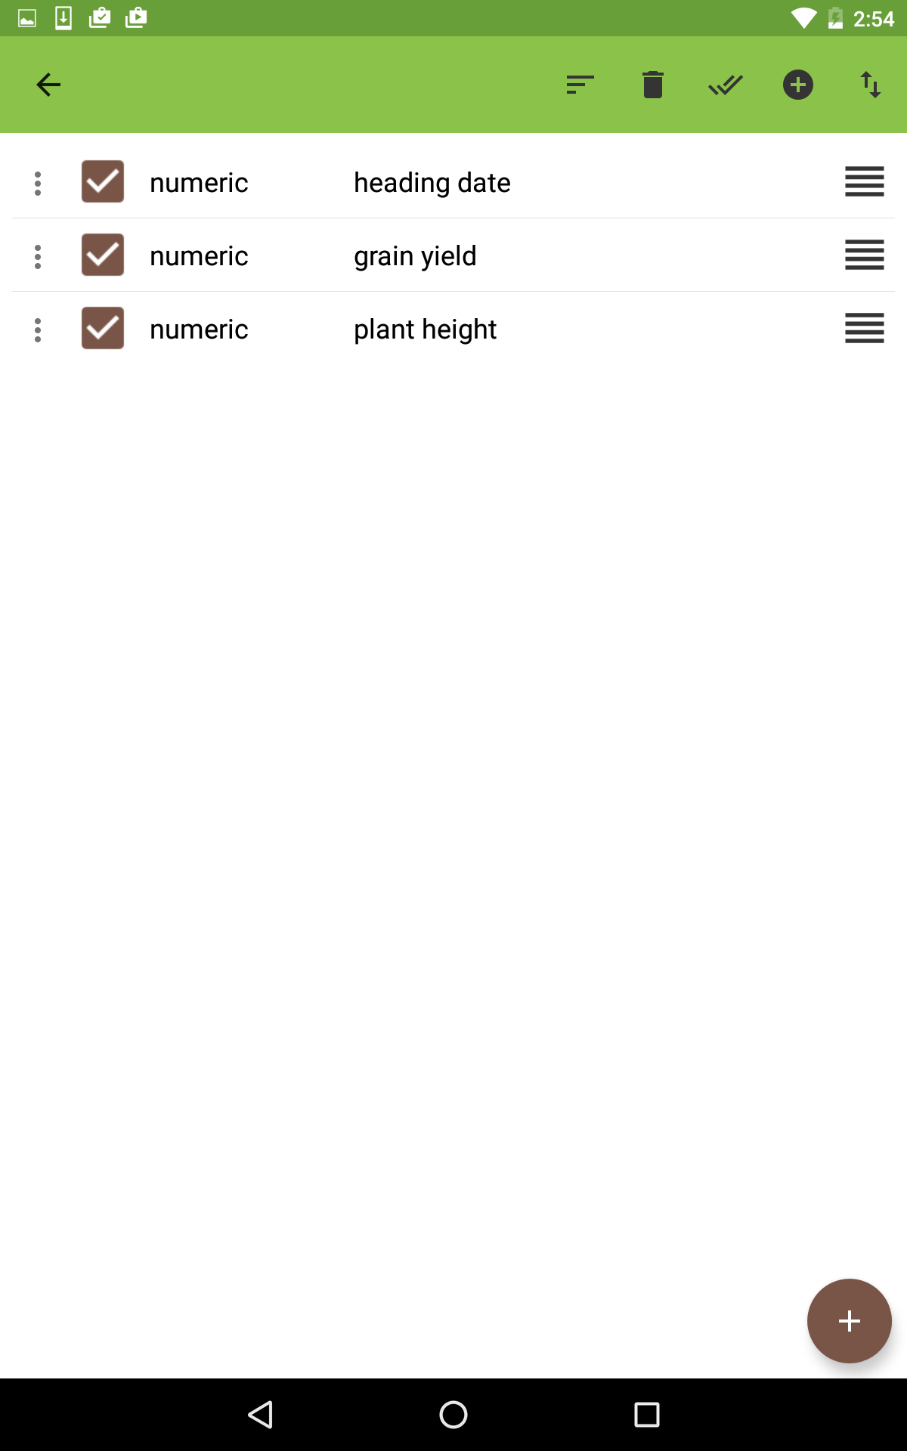
Section 3: Importing files to the Android Field Book
The traits from the T3 trait import file should now be displayed in the trait window of the AFB app
Click the back arrow ⬅ in the top left corner of the app to reach the settings menu again
Select the back arrow ⬅ again to reach the data entry screen

Slide 25
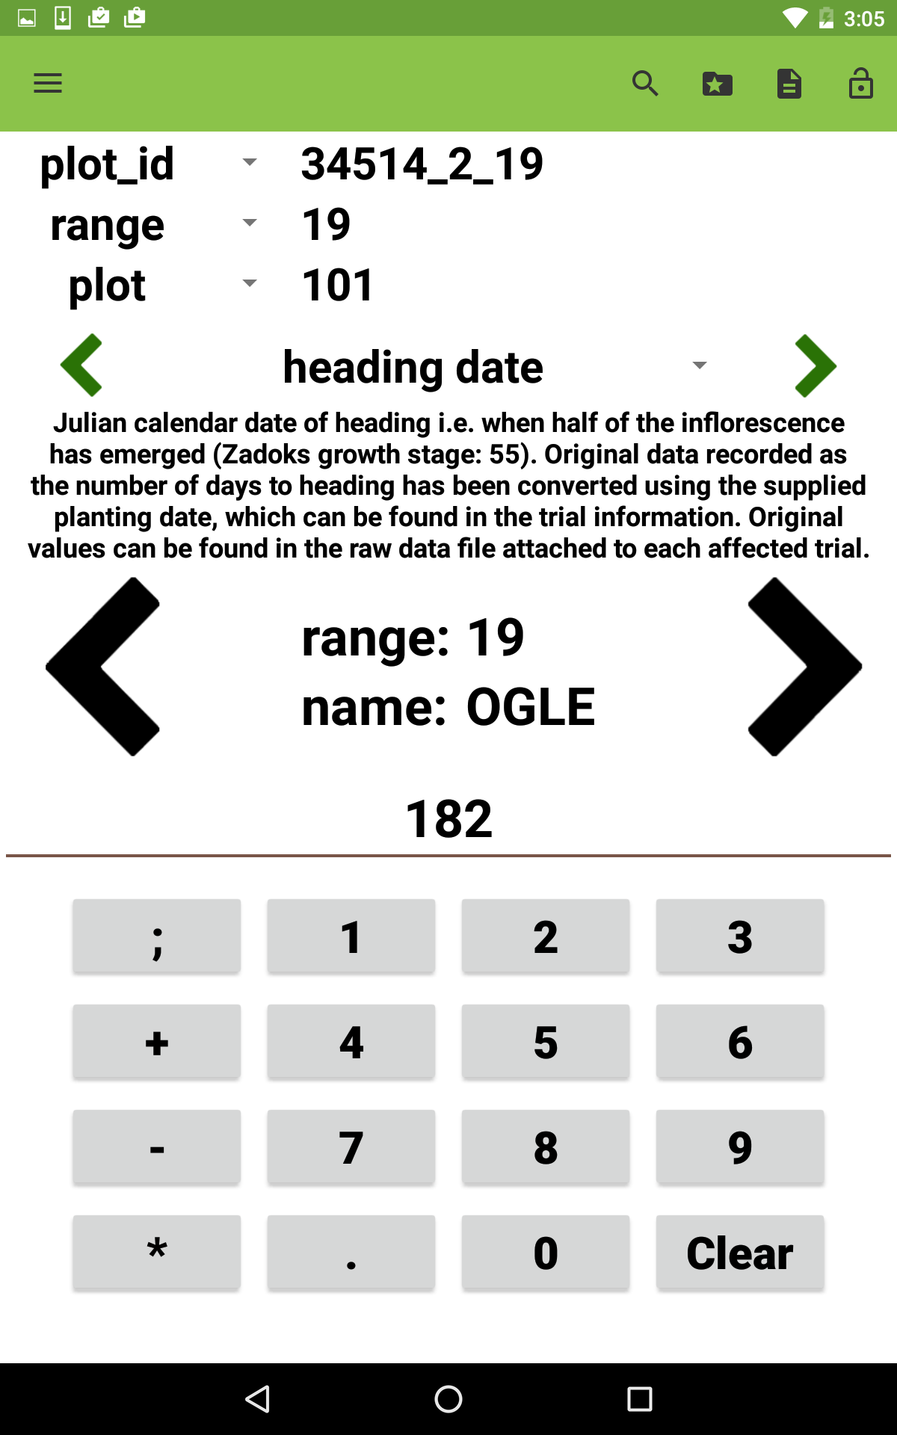
Section 4: Recording measurements in the Android Field Book
The small green arrows navigate between traits
The large black arrows navigate through the plots
Use the keypad to record measurements

Slide 26
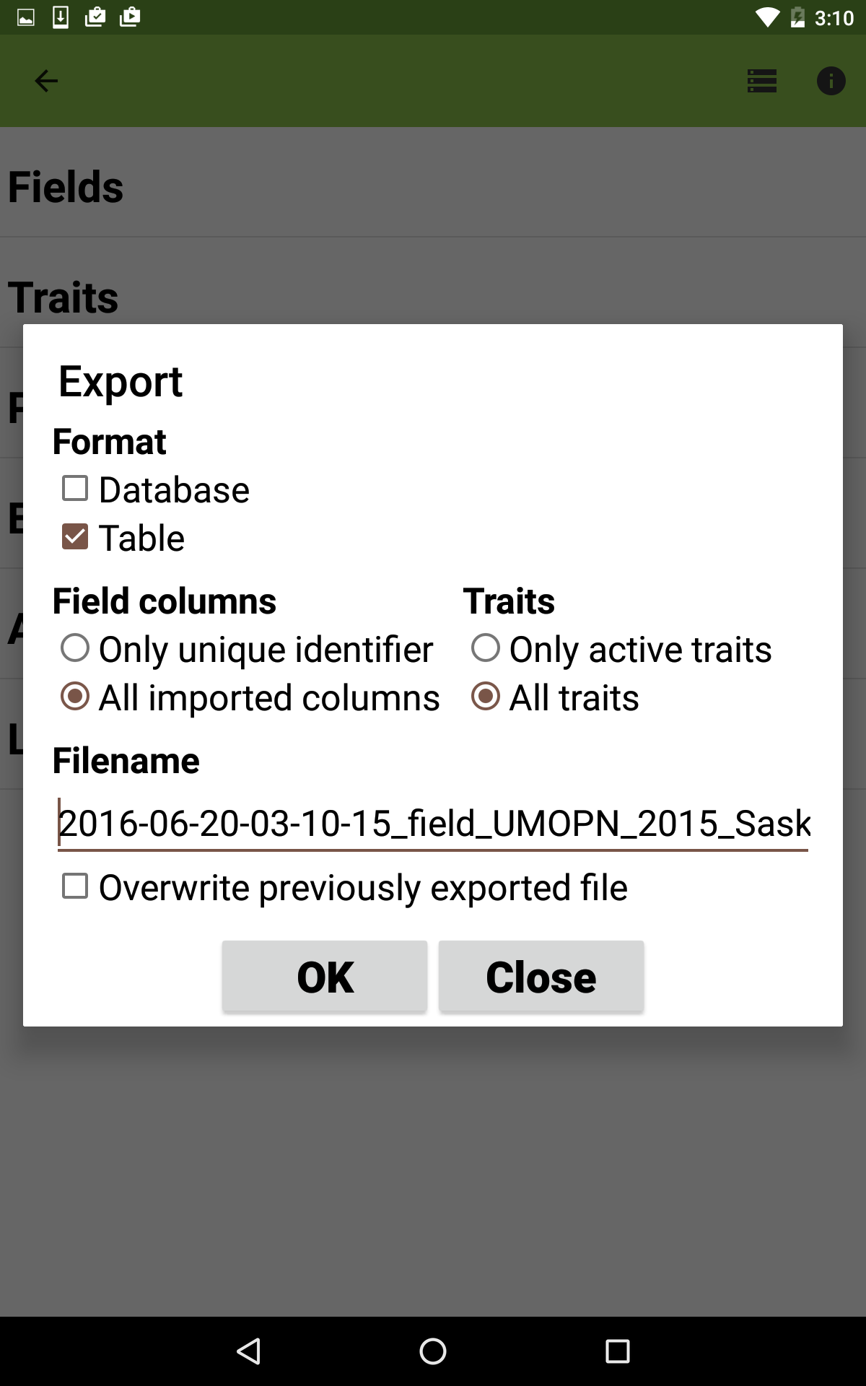
Section 5: Exporting trial results from the Android Field Book
Navigate to the Settings menu
Select “Export”
Choose the “Table” format
Clicking “OK” will create a file that can be uploaded directly to T3.

Slide 27
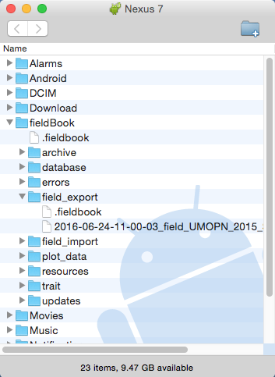
Section 5: Exporting trial results from the Android Field Book
Connect your tablet to your computer
The exported results file will appear in the “field_export” folder within the AFB folder on your tablet
Save the results file to your computer
The next step is to upload your results to the T3/Oat Sandbox.
The Android File Transfer program for Mac

Slide 28
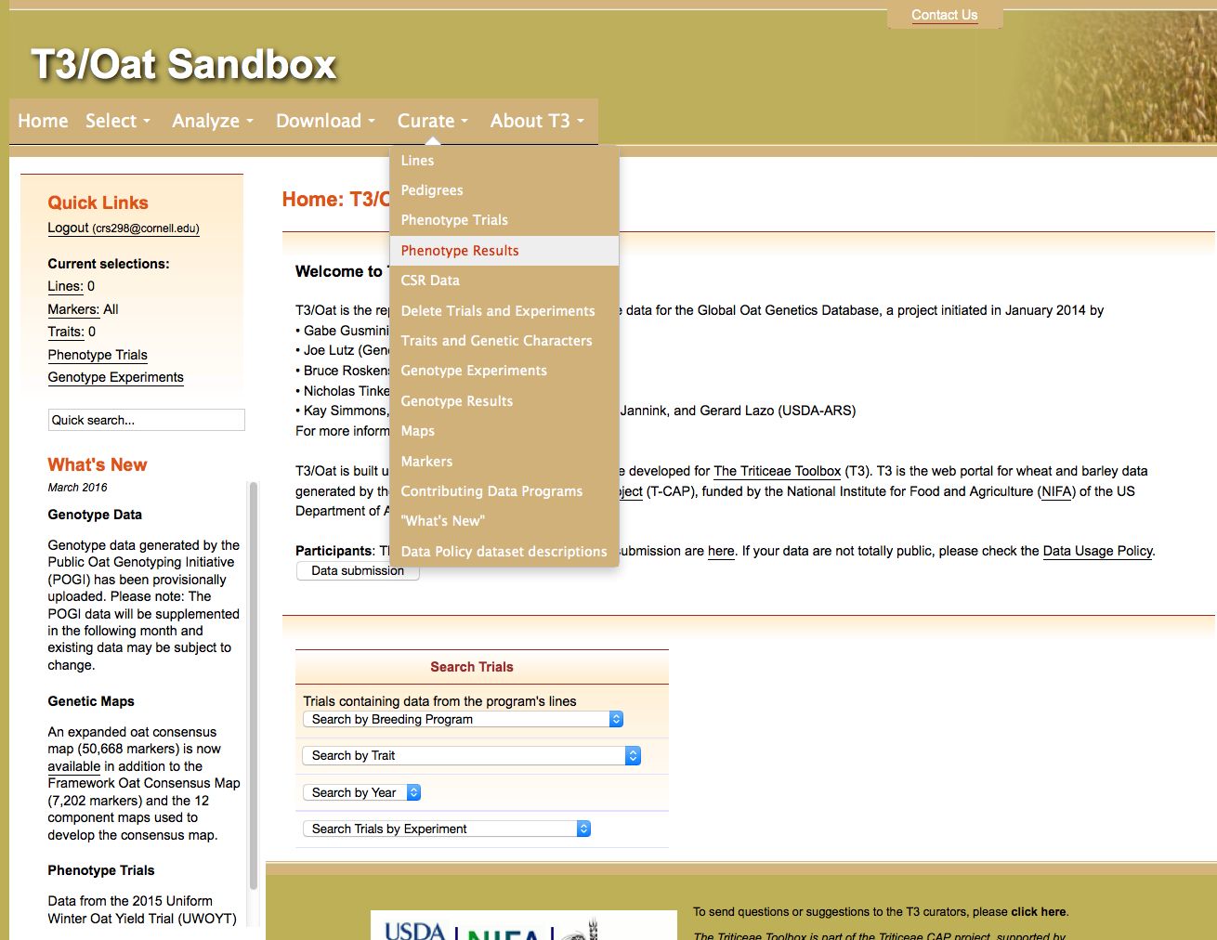
Section 6: Uploading Android Field Book trial results to the T3/Oat Sandbox
Navigate to the T3/Oat Sandbox at https://t3sandbox.org/t3/sandbox/oat/
The curation menu will appear once you register and login
Choose the Curate menu> Phenotype Results

Slide 29
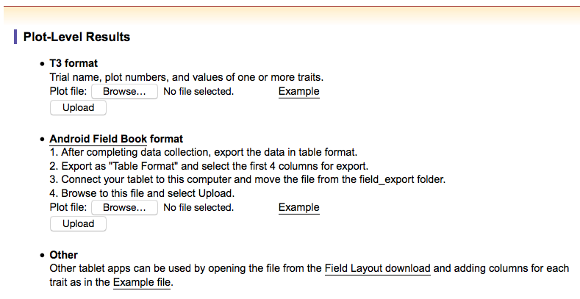
Section 6: Uploading Android Field Book trial results to the T3/Oat Sandbox
Under the “Android Field Book format” heading, browse for and upload the plot-level results recorded using the AFB app.

Slide 30
Section 7: Submitting the Android Field Book trial to T3/Oat
You should be in possession of a:
Trial description file
Field layout file
Plot-level results file
The file of T3 traits does not need to be uploaded to T3.
The final step is to submit these three documents to the curator for upload to the T3/Oat database.

Slide 31
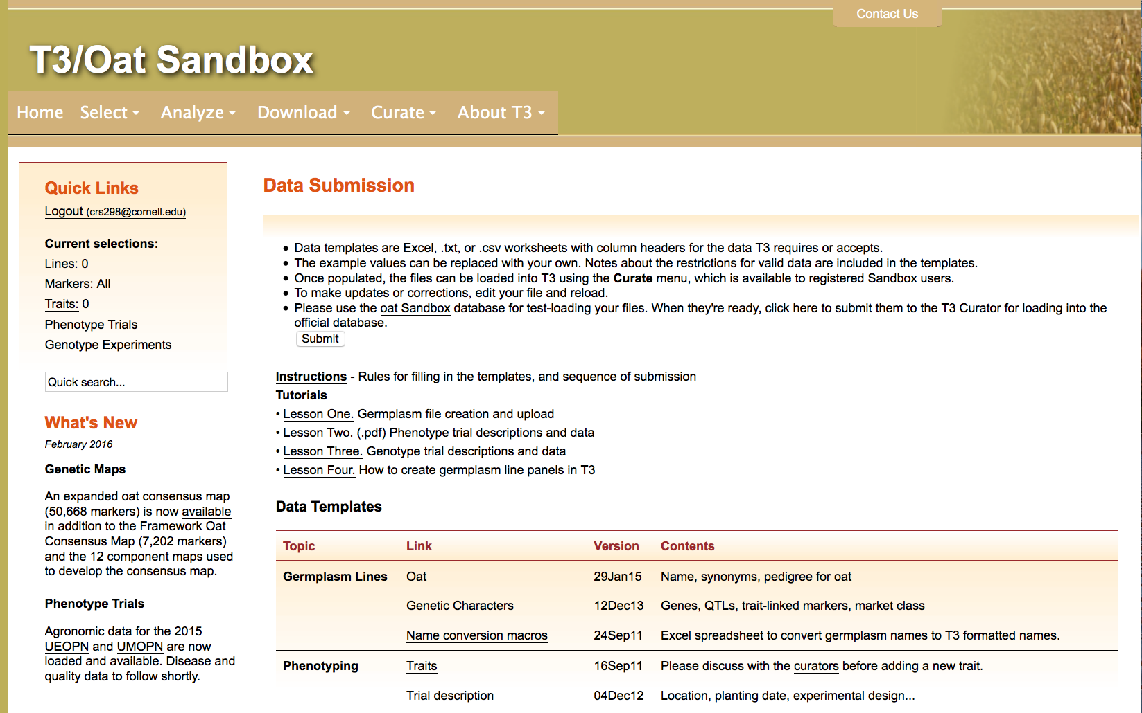
Section 7: Submitting the Android Field Book trial to T3/Oat
Navigate to the Data Submission page from the About T3 menu
Click the “Submit” button

Slide 32
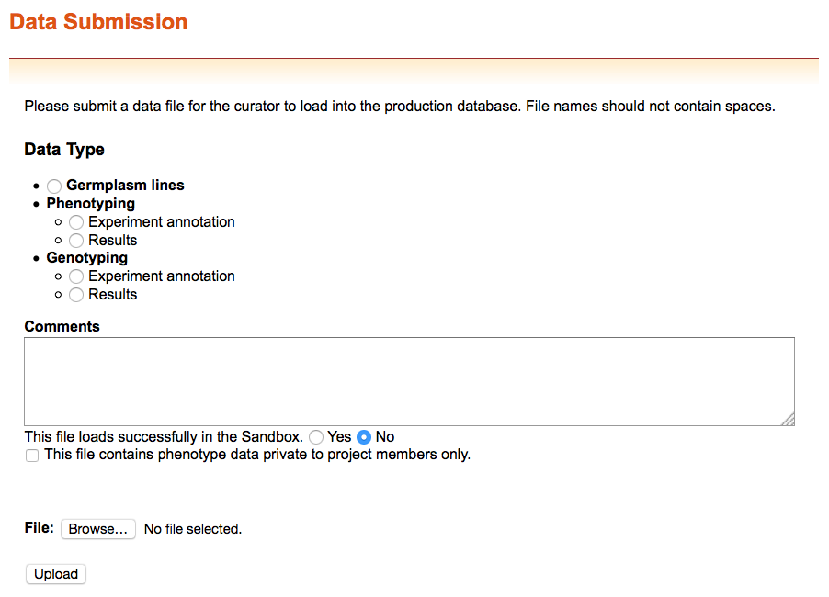
Section 7: Submitting the Android Field Book trial to T3/Oat
You can submit files that do not successfully upload to the T3/Oat Sandbox to receive help from the curator

Slide 33
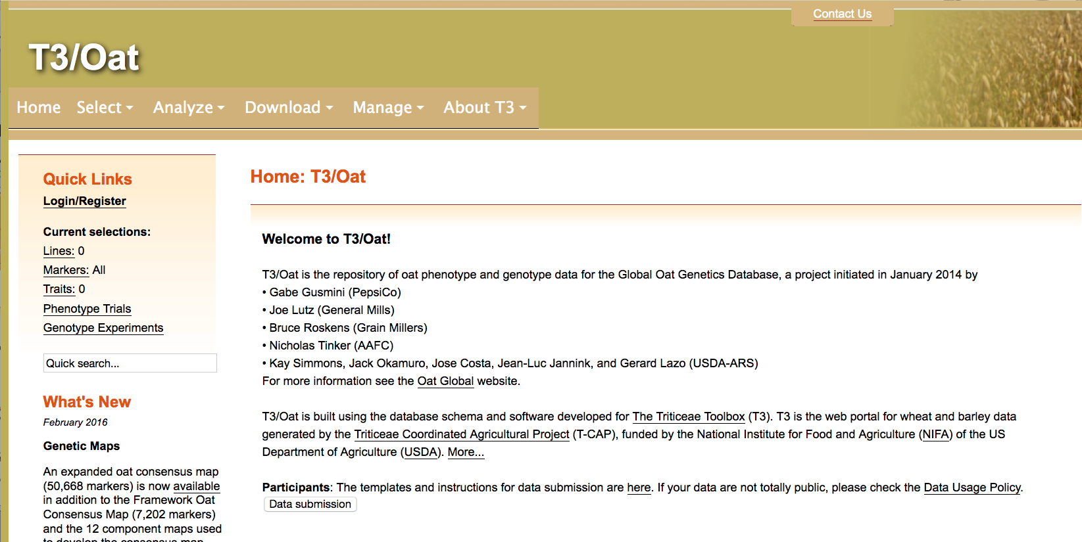
Contact Us
Please contact us if you need help using T3

